Slide 1
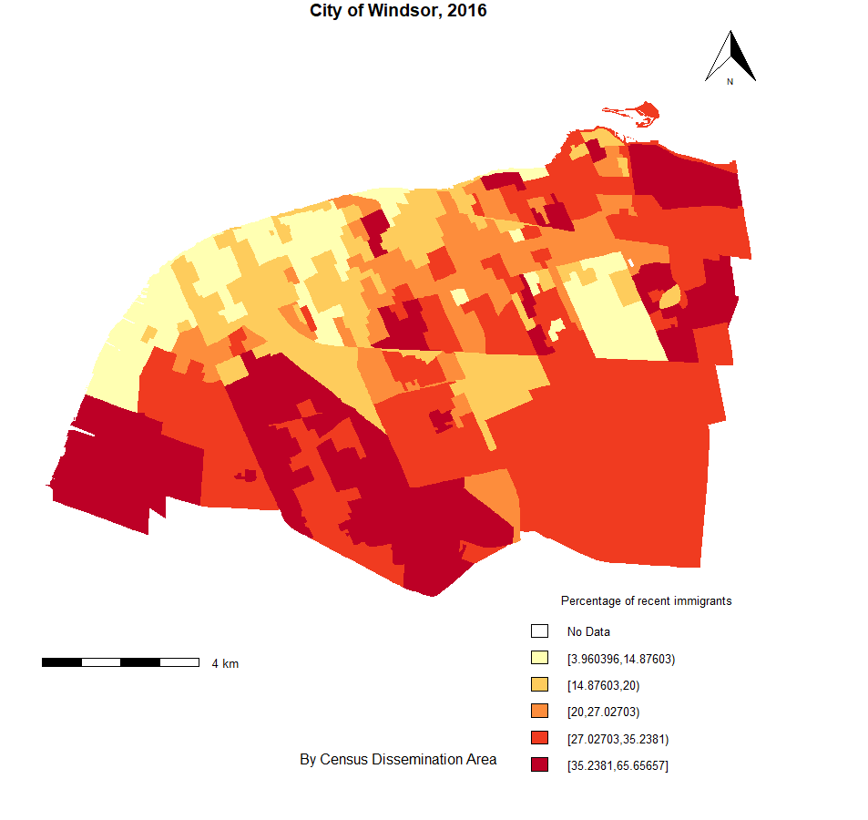
Mapping the Census with R
Carina Xue Luo
Leddy Library’s Academic Data Centre

Slide 2
Housekeeping Rules
This workshop is being recorded
All participants will be muted during the workshop
Questions can be submitted via Chat at any time and will be answered at the end of the workshop
Workshop’s datasets, slides and recording will be shared through Blackboard

Slide 3
Learning Objectives
By the end of this workshop, you will be able to:
Understand census data and census geography
Obtain and clean census data
Join census attribute table to census boundary files
Create a thematic map to identify patterns about the population

Slide 4
Getting Started
What is R?
A programming language and free software environment for data analysis, graphics and statistical computing.
What is RStudio?
RStudio is an Integrated Development Environment (IDE) for the R language.
What are R packages?
R packages are a collection of R functions, complied code and sample data.
By default, R installs a set of packages during installation. More packages are added later, when they are needed for some specific purpose.
What is a thematic map?
A map where geographic areas are colored, shaded, or patterned in relation to the value of a particular variable measured for each area (e.g., population density, average income). It is particularly useful to investigate how a measurement varies across a geographic region.

Slide 5
Census of Canada
A complete, mandatory survey of the population collected by Statistics Canada.
Among one of the most important datasets providing information about Canadian population and housing units by their demographic, social and economic characteristics.
Currently conducted at 5-year intervals. Every 10 years before until 1971.
Data released at varying levels of geography.
Only source for neighbourhood-level data
1971 – 2006: two forms were used to collect information from residents.
Short form: basic questions such as age, sex, marital status, housing.
Long form: language, ethnicity, immigration, employment, income, etc.
Sample size: 80% of households received a short questionnaire and 20% were given the long form (except for 1971 when it was 1 in 3 households).
2011: Census is the former short form, plus questions on language from long form. Mandatory long form was replaced by the voluntary National Household Survey (1 in 3 households).
2016: Long form census is reinstated (25% of households). The remaining 75% received the short form.

Slide 6
How Census is Related to Geography?
Census data are disseminated by a variety of geographic areas which are designed specifically for disseminating data.
The geographic areas used for disseminating census data range in size from Canada, provinces and territories, all the way down to dissemination blocks.

Slide 7
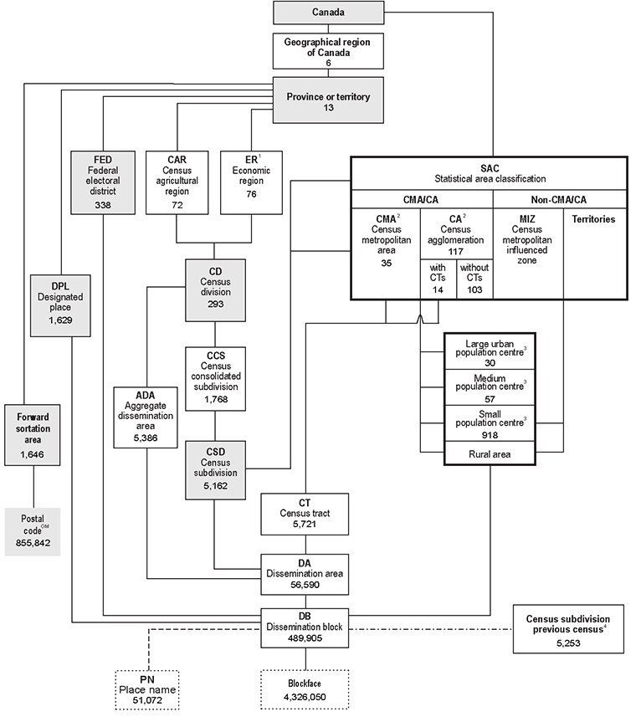
Standard geographic areas used for data dissemination and their relationships to one another.
Source: https://www12.statcan.gc.ca/census-recensement/2016/ref/dict/figures/f1_1-eng.cfm

Slide 8
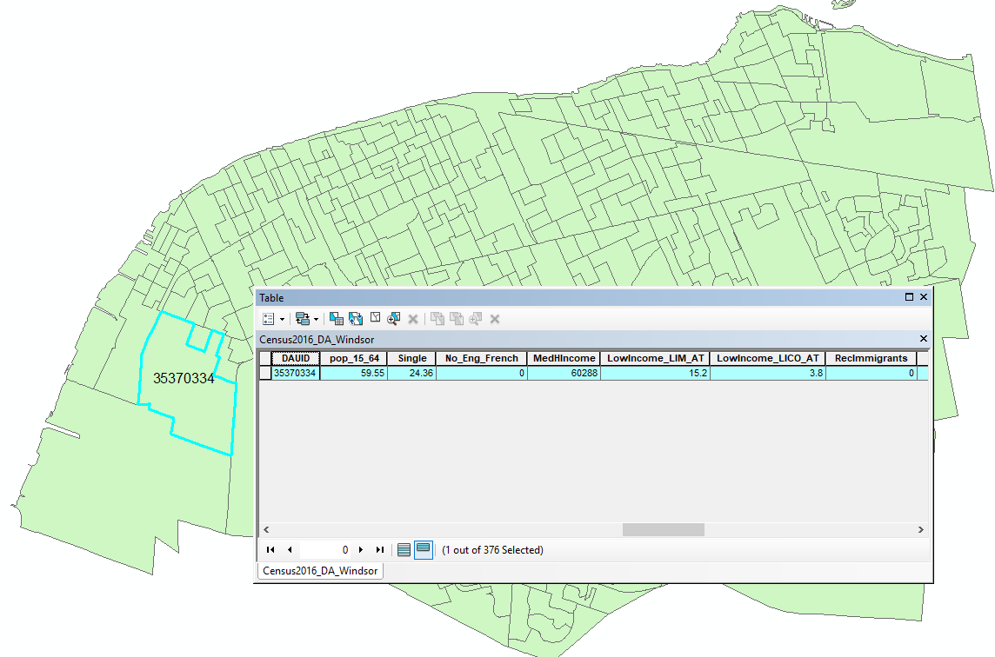
Statistics Canada releases boundary files for these standard geographic areas along with census variables. Each unit of these geographic areas has a unique identifier which makes it possible to locate them on the ground and relate census statistics to them.

Slide 9
Which census geography do I need?
It depends entirely on the type of your research and what you want to look at.
You may be looking for Canada as a whole, a province, a municipality, or a smaller geographic level. Or, you may want to create your own custom area.
E.g., You may want to know the number of people who worked outside Canada in the city of Windsor, or you may want to compare income differences among neighbourhoods within the city. Or you may want to get a profile of the population that lives within a 10-minute drive of the university.

Slide 10
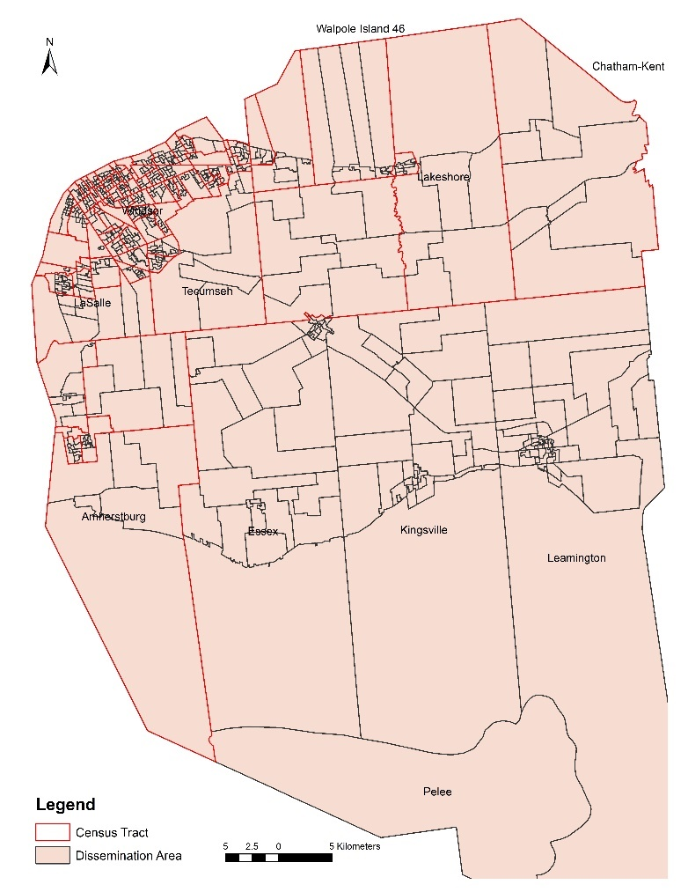
Neighbourhood Analysis
Comparing neighbourhoods in a city or town usually involves looking at census tracts (CTs) or dissemination areas (DAs). Each CT usually has a population between 2,500 and 8,000 persons. They are located in census metropolitan areas (might not cover rural areas). Dissemination areas (DAs) fit within CTs and has an average population of 400 to 700 persons. DAs are the smallest standard geographic area for which all census data are released and cover all the territory of Canada.
CT boundaries were relatively stable over years compared to DA which was introduced in 2001.

Slide 11
Hands-on Time
Download the census attribute data and boundary files
A csv (comma-separated values) file containing census variables at the DA level
a shapefile containing DA’s boundaries
Load the data into R and join them together
Make a map that shows Windsor’s DAs in different colors according to their population density

Slide 12
Download and install R, RStudio and Datasets
Download and install R
Windows User: https://cran.r-project.org/bin/windows/base/
Mac User: https://cran.r-project.org/bin/macosx/
Install RStudio Desktop https://www.rstudio.com/products/rstudio/download/
Download workshop datasets
https://uwin365-my.sharepoint.com/:u:/g/personal/carina_uwindsor_ca/EVt53WkIEVdJs7noee3IeFcB5Bud1xF_346cLkEXKN_y-Q?e=s3aH5o
Notes:
The newest version of R is 4.0.3. Rstudio 1.4.1103

